Slide 1
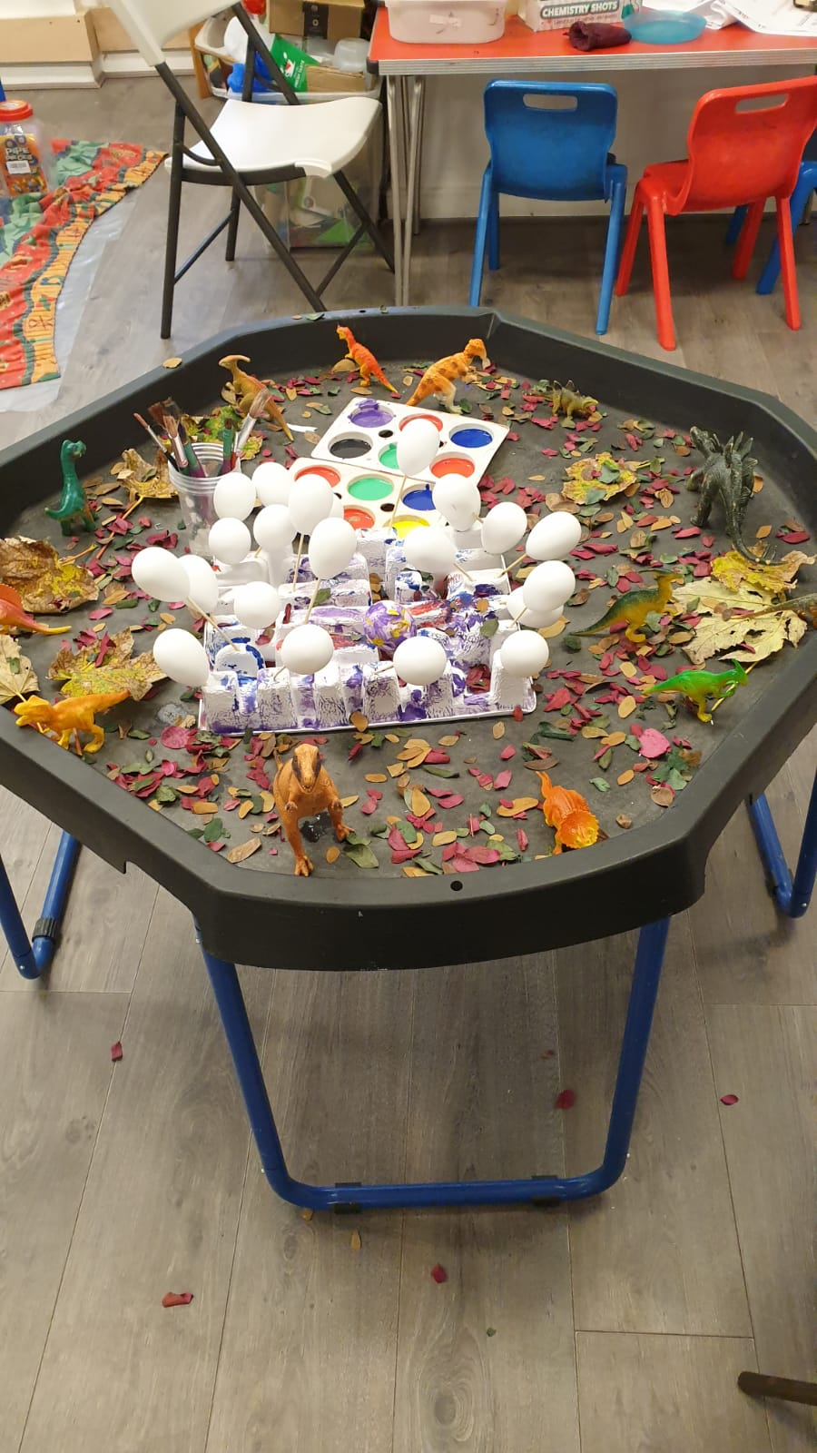
What is a learning journal?
A learning journal is a record of each child’s learning and shows snap shots of children’s achievements and progress in relation to the EYFS. Not every activity they do will be recorded as a rough guide there should be a new entry on each week. Some times more sometimes less!

Slide 2
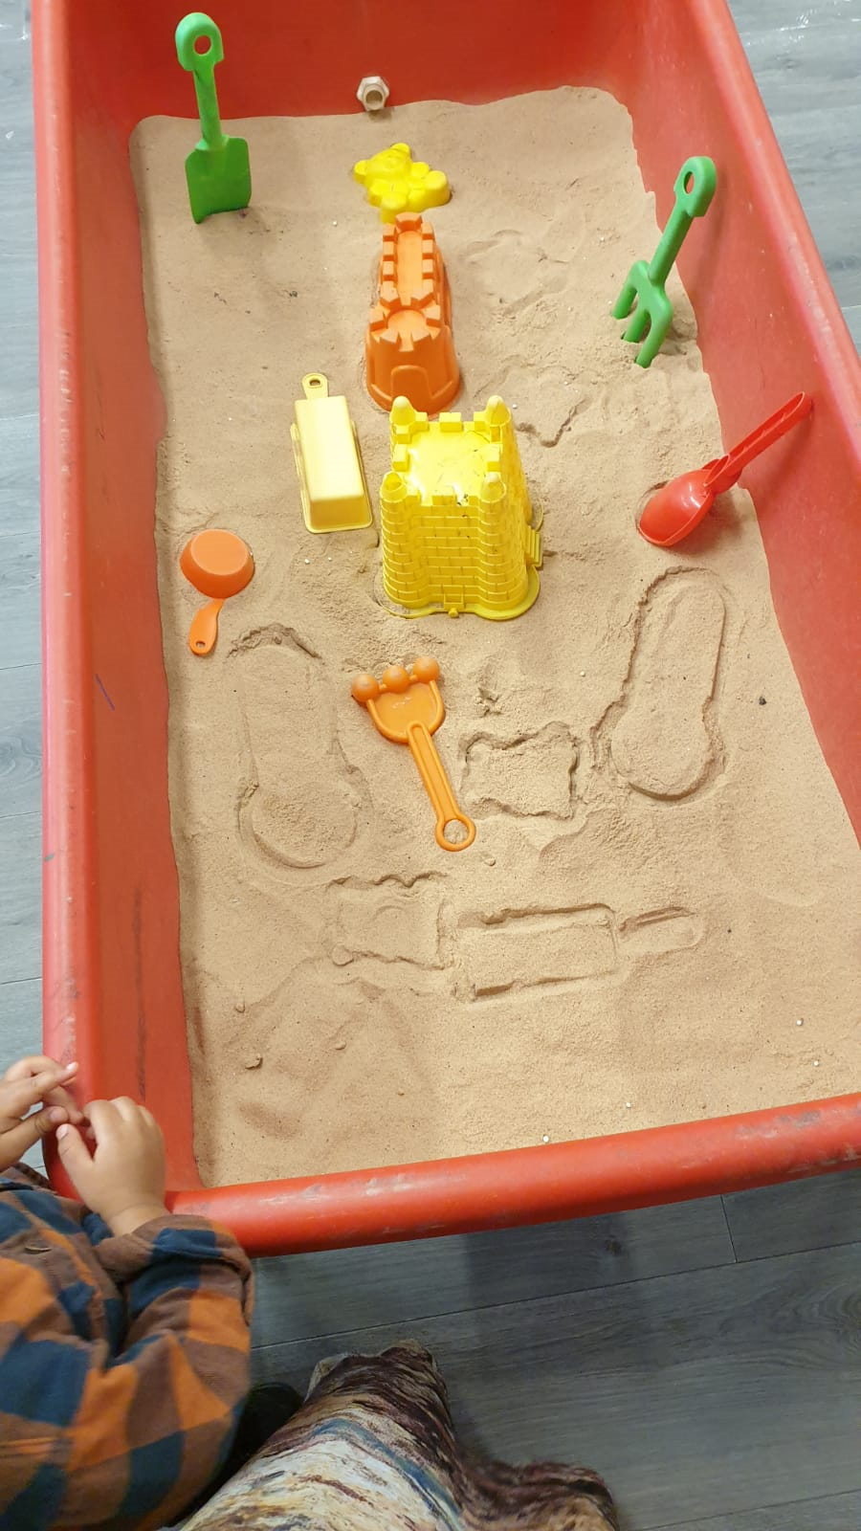
What should I put in my child’s learning journal?
You can put in photos of things they have made at home or activities they have done.
You can write a quick comment about something they have said or noticed.
You can reply to observations staff have made

Slide 3
Who can see my child’s learning journal?
Only staff at ANS can see all of the Childrens learning journeys.
You set up a secure password to access your child’s account and only you can see your child’s journal.
Occasionally there maybe children in the background of photos or children may be working together, if you do not wish your child to be on photos that may appear in others learning journals, please let staff now.

Slide 4
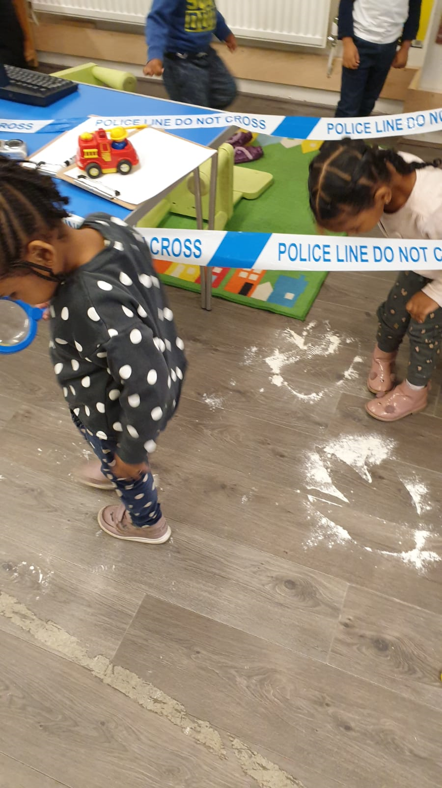
What should I put in my child’s learning journal?
You can add photos about things they have done with you so we can talk about them in Nursery

Slide 5
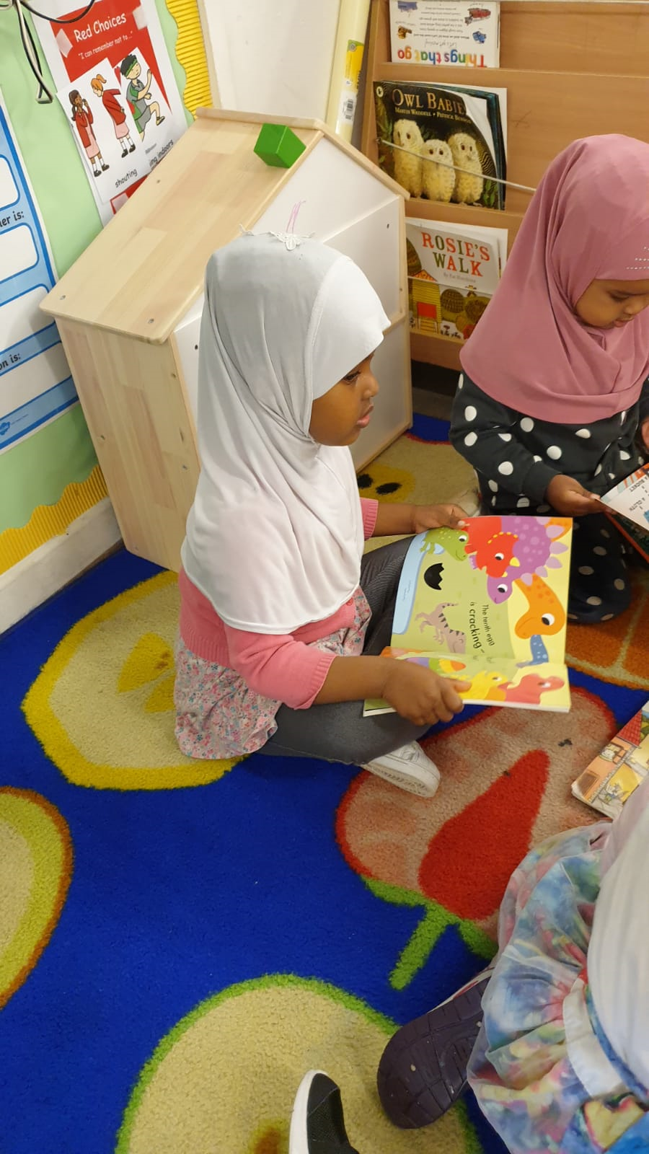
How do I log in?
You just need your username – which is the email address you have given us and the password that you set up the first time you log on.
You can either go through the web page or down load the app. The links are on our website.

Slide 6
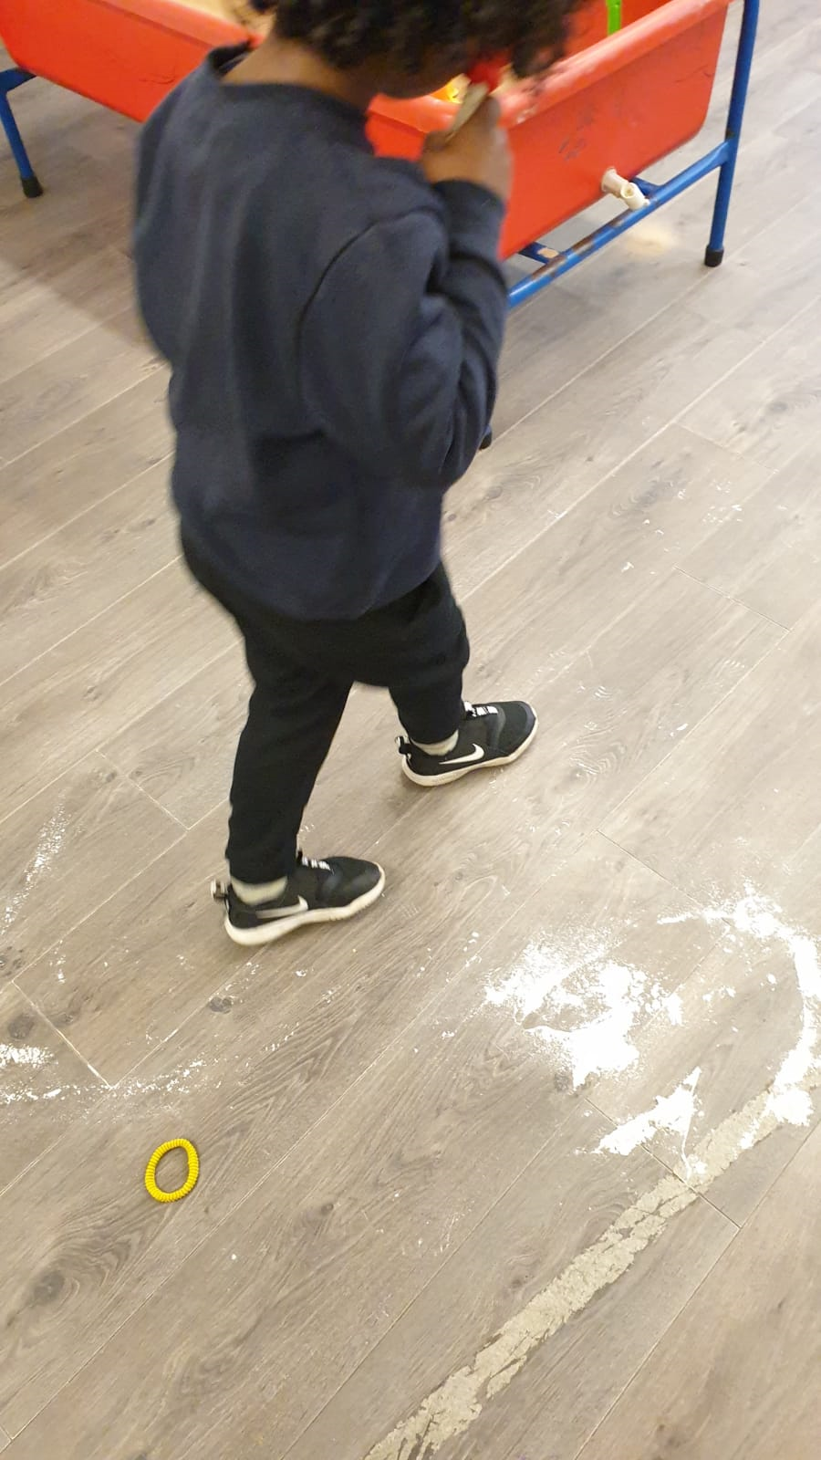
What should I put in my child’s learning journal?
You can let us know if they enjoyed an activity and can talk about it at home

Slide 7
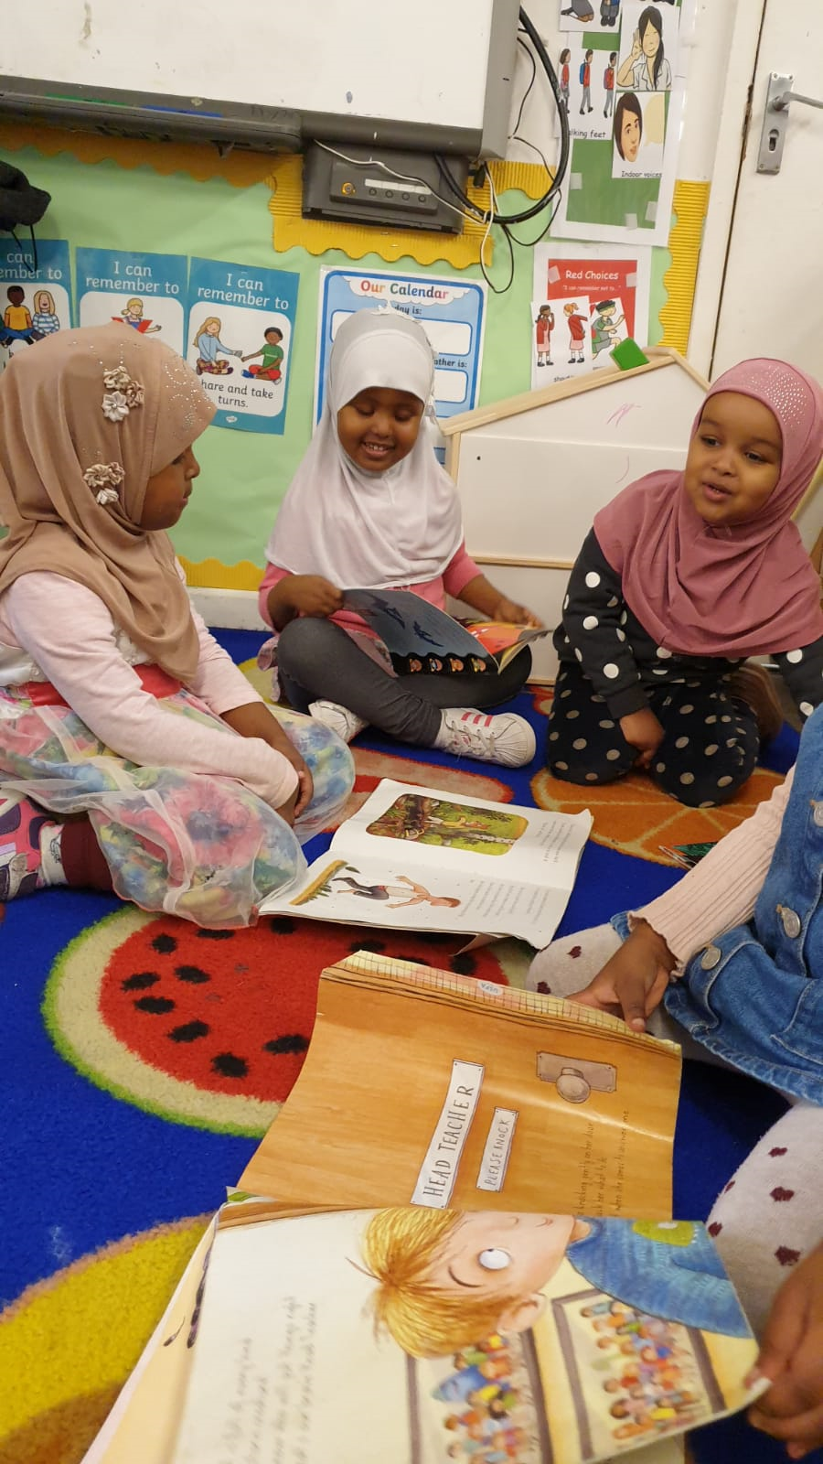
What will happen to the information when my child leaves Assunnah Nursery School?
When your child leaves we will download the information on Tapestry on to a CD-ROM so that you will have a
copy to keep forever.

Slide 8
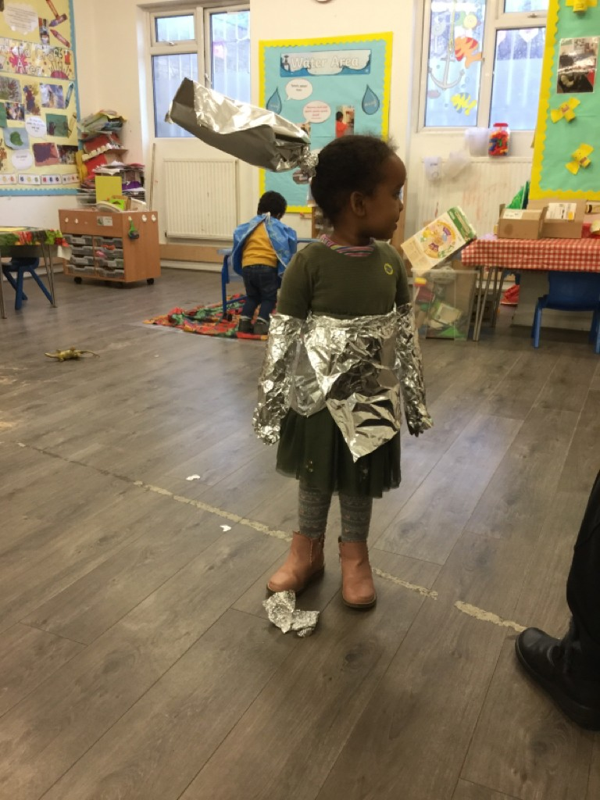
What should I put in my child’s learning journal?
You can let us know if they carry their learning on at home.
Haala enjoyed being a robot for a day. Haala was able to demonstrate how a Robot might move and stated “he walks side to side and turns around!“

